Slide 1
GOD’S LAWS OF HEALTH
NUTRITION
EXERCISE
WATER
SUNLIGHT
TEMPERANCE
AIR
REST
TRUST IN GOD
NEWSTART

Slide 2
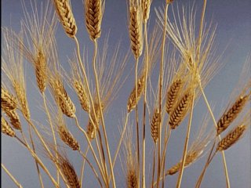
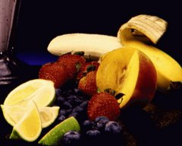
NUTRITION
Ge:1:29: And God said, Behold, I have given you every herb bearing seed, which is upon the face of all the earth, and every tree, in the which is the fruit of a tree yielding seed; to you it shall be for meat.
NEWSTART

Slide 3
NUTRITION
Beans are high in protein (building blocks) and maize or rice is high in carbohydrates (energy).
Together beans and maize or rice make a healthful combination.

Slide 4
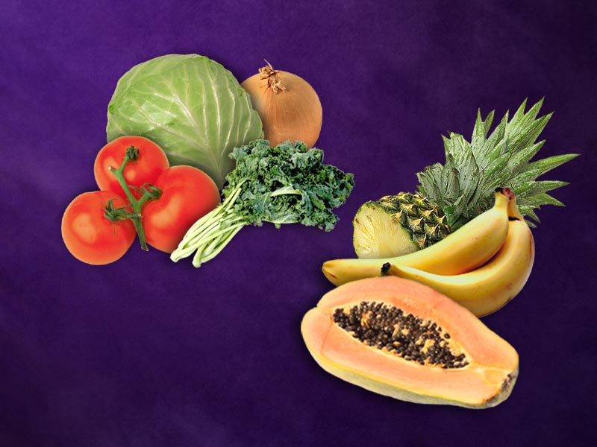
NUTRITION
When we eat plant foods of different colours and kinds, we supply our bodies with the best nutrients possible.
Plant foods supply us with:
Carbohydrates
Protein
Vitamins (and)
Minerals
Fruits and vegetables

Slide 5
NUTRITION
Rice, wheat, and other grains are cheap to grow or buy in most countries. They are more helpful to the body if their outer skins are not removed by milling; leave them brown. This is the most healthful way to eat them.
Compared to the common white, over-milled or polished grain, grains that have not been milled contain more:

Slide 6
NUTRITION
Protein (building blocks)
Vitamins (and) Minerals (the parts of the grain that help our body be strong and healthy).
The protein in rice, maize, and other grains is better used by the body when eaten with beans, lentils or other legumes or nuts sometime during the same day.
Protein
Vitamins
Minerals
Grains

Slide 7
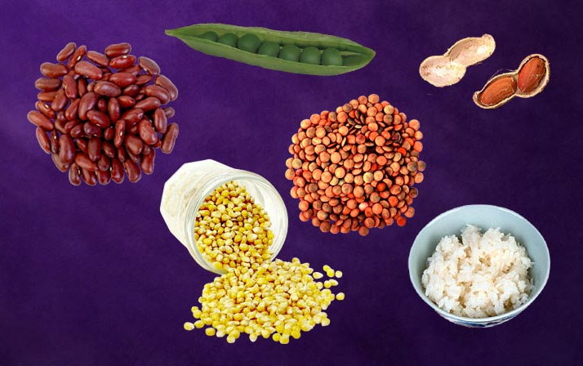
NUTRITION
Peas
Groundnuts
Beans
Lentils
Corn
Rice

Slide 8
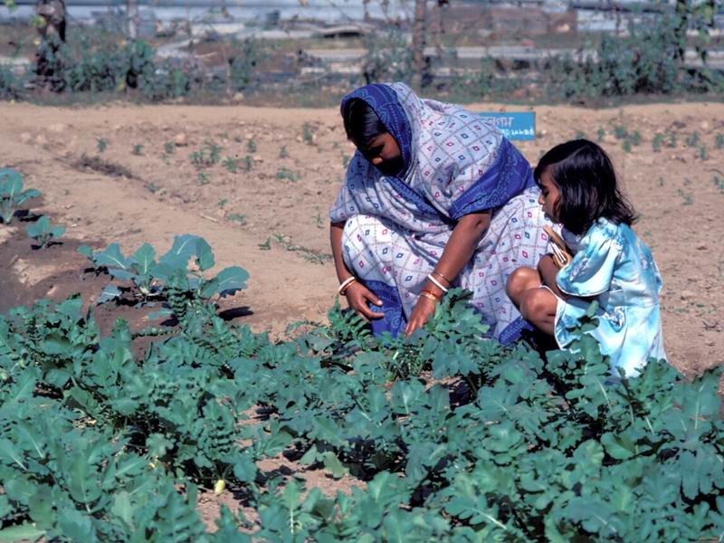
NUTRITION
The leaves of many plants such as, sweet potatoes, beans and peas, pumpkins and squash as well as kale, spinach, and collards are especially nutritious.

Slide 9
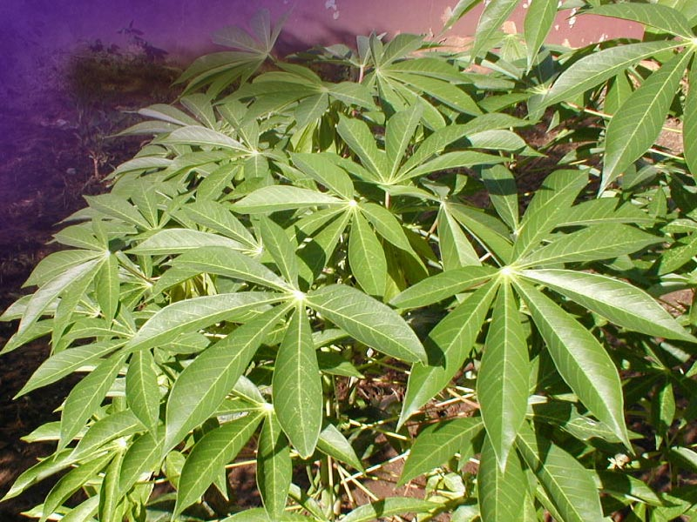
NUTRITION
Cassava leaves
Cassava (manioc) leaves contain more vitamins and seven times more protein than the root. Eating both the root and leaves adds food value at no extra cost.

Slide 10
HEALTH SONG (refrain)
Health for you!
Health for me!
Health for all mankind!
Healing for the halt and lame,
And vision for the blind;
Health for you!
Health for me!
Health for all mankind!
This our goal:
Our body whole
In spirit, flesh, and mind.

Slide 11
HEALTH SONG
Sunshine and fresh air,
Clean and wholesome food,
Proper exercise,
Thoughts upright and good,
Keeps the cheeks aglow,
Bodies fit and strong,
Keep the brain alert and clean,
And give the heart a song!

Slide 12
HEALTH SONG (refrain)
Health for you!
Health for me!
Health for all mankind!
Healing for the halt and lame,
And vision for the blind;
Health for you!
Health for me!
Health for all mankind!
This our goal:
Our body whole
In spirit, flesh, and mind.

