Slide 1
GOD’S LAWS OF HEALTH
NUTRITION
EXERCISE
WATER
SUNLIGHT
TEMPERANCE
AIR
REST
TRUST IN GOD
NEWSTART

Slide 2
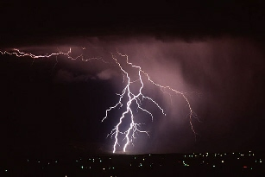
AIR
Ge:2:7: And the LORD God formed man of the dust of the ground, and breathed into his nostrils the breath of life; and man became a living soul
Eze:37:9: Then said he unto me, Prophesy unto the wind, prophesy, son of man, and say to the wind, Thus saith the Lord GOD; Come from the four winds, O breath, and breathe upon these slain, that they may live.
Eze:37:10: So I prophesied as he commanded me, and the breath came into them, and they lived, and stood up upon their feet, an exceeding great army. soul.
NEWSTART

Slide 3
AIR
Those whose habits are sedentary should, when the weather will permit, exercise in the open air every day, summer or winter. Walking is preferable to riding or driving, for it brings more of the muscles into exercise. The lungs are forced into healthy action, since it is impossible to walk briskly without inflating them. MH p.240
NEWSTART

Slide 4
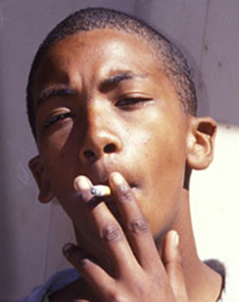
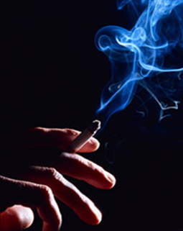
AIR
Imagine lighting a cigarette and drawing a puff of black smoke into your mouth, throat, and lungs; it’s amazing that anyone would be willing to even try it!

Slide 5
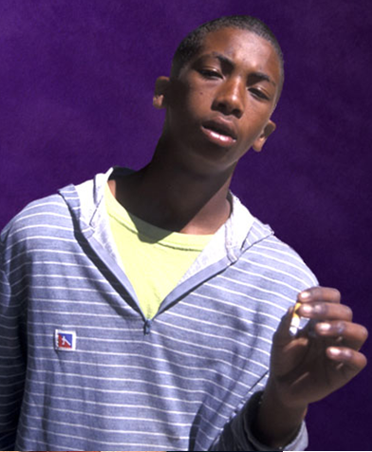
What is the result?
Much suffering and death. Every 10 seconds, someone in the world dies from an illness caused by using tobacco.
CNN Interactive News, As smoking goes passé
AIR

Slide 6
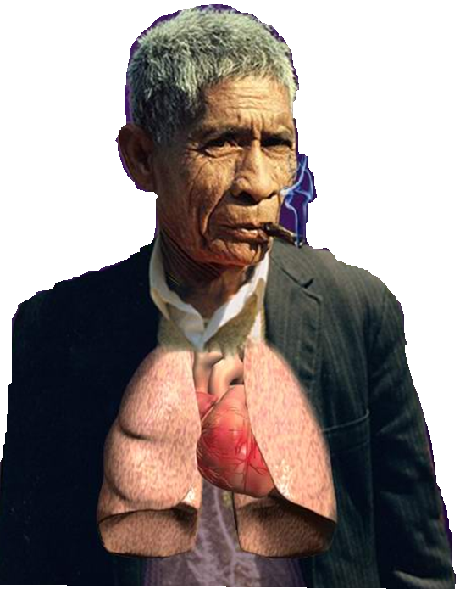
AIR
When you use tobacco, your whole body feels it immediately. Your heart beats faster and your blood pressure goes up. Breathing becomes faster and not as deep. Even your blood circulation becomes weaker. Every cigarette is shortening your life.
British Columbia Ministry of Health, Canada, Tobacco Truth, Tobacco Facts, What does tobacco do to your body?, http://www.tobaccofacts.org/tru-affects.html
AIR

Slide 7
Tobacco and its smoke are full of poisons. These affect the brain, making a habit that is harder to break than drinking alcohol.
More than 3.700 substances

Slide 8
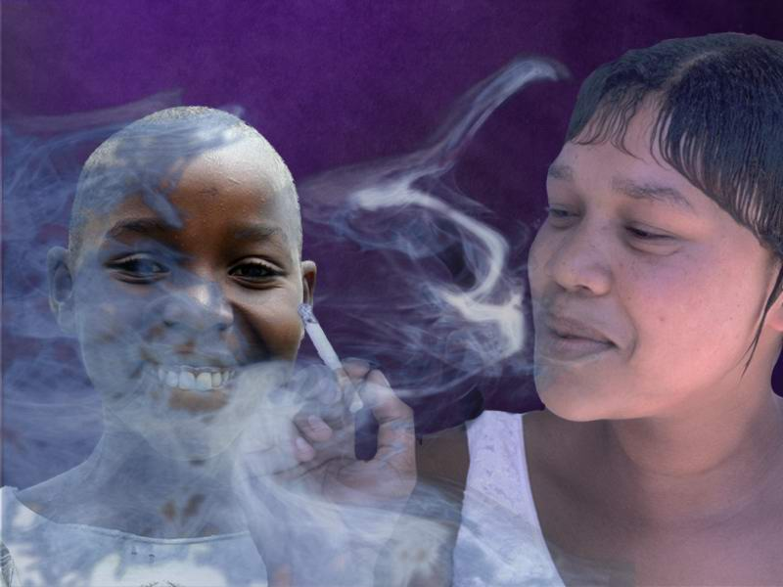
AIR
Even people who do not smoke can get dangerous diseases, just from breathing air with smoke from nearby smokers.
Children suffer a lot from breathing air filled with tobacco smoke.

Slide 9
Air
The 4-7-8 Breathing Exercise
Sit up straight
Place the tip of your tongue up against the back of your front teeth. Keep it there through the entire breathing process
Breathe in silently through your nose to the count of four
Hold your breath to the count of seven
Exhale through your mouth to the count of eight, making an audible “woosh” sound
That completes one full breath. Repeat the cycle another three times, for a total of four breaths

Slide 10
HEALTH SONG

Slide 11
HEALTH SONG (refrain)
Health for you!
Health for me!
Health for all mankind!
Healing for the halt and lame,
And vision for the blind;
Health for you!
Health for me!
Health for all mankind!
This our goal:
Our body whole
In spirit, flesh, and mind.

Slide 12
HEALTH SONG
Sunshine and fresh air,
Clean and wholesome food,
Proper exercise,
Thoughts upright and good,
Keeps the cheeks aglow,
Bodies fit and strong,
Keep the brain alert and clean,
And give the heart a song!

Slide 13
HEALTH SONG (refrain)
Health for you!
Health for me!
Health for all mankind!
Healing for the halt and lame,
And vision for the blind;
Health for you!
Health for me!
Health for all mankind!
This our goal:
Our body whole
In spirit, flesh, and mind.

