Slide 1
GOD’S LAWS OF HEALTH
NUTRITION
EXERCISE
WATER
SUNLIGHT
TEMPERANCE
AIR
REST
TRUST IN GOD
NEWSTART

Slide 2
REST
Heb:4:9: There remaineth therefore a rest to the people of God.
Heb:4:10: For he that is entered into his rest, he also hath ceased from his own works, as God did from his.
Heb:4:11: Let us labour therefore to enter into that rest, lest any man fall after the same example of unbelief.

Slide 3
REST
M't:11:28: Come unto me, all ye that labour and are heavy laden, and I will give you rest.
M't:11:29: Take my yoke upon you, and learn of me; for I am meek and lowly in heart: and ye shall find rest
M'r:6:31: And he said unto them, Come ye yourselves apart into a desert place, and rest a while: for there were many coming and going, and they had no leisure so much as to eat. unto your souls.

Slide 4
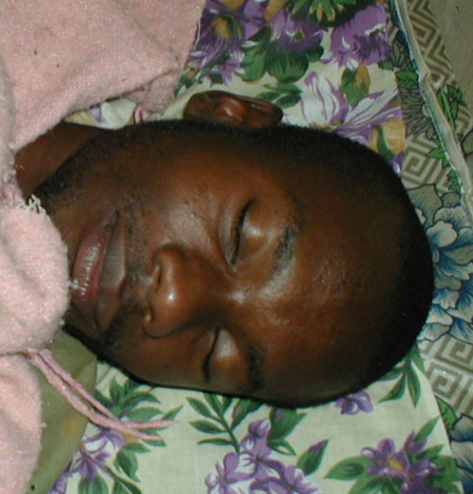
REST
Avoid staying up late, and get plenty of rest. Eight hours of sleep is best. When we are tired our self-control becomes weakened, making it harder to resist temptation.
NEWSTART

Slide 5
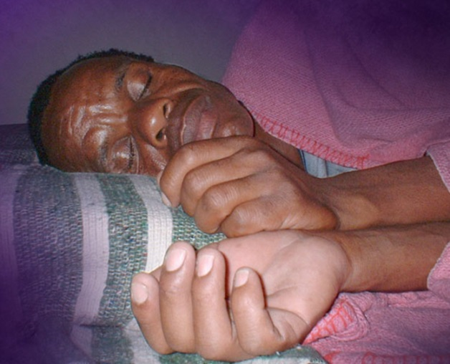
REST
Some make themselves sick by overwork. For these, rest, freedom from care, and a spare diet, are essential to restoration of health.
NEWSTART

Slide 6
REST
To those who are brain weary and nervous because of continual labor and close confinement, a visit to the country, where they can live a simple, carefree life, coming in close contact with the things of nature, will be most helpful. Roaming through the fields and the woods, picking the flowers, listening to the songs of the birds, will do far more that any other agency toward their recovery. MH Page 237
NEWSTART

Slide 7
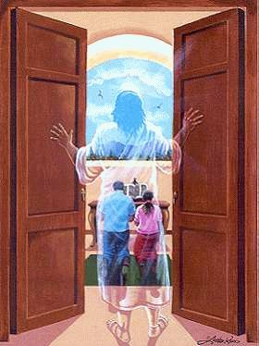
REST
Ex:20:10: But the seventh day is the sabbath of the LORD thy God: in it thou shalt not do any work, ..........
Ex:20:11: For in six days the LORD made heaven and earth, the sea, and all that in them is, and rested the seventh day: wherefore the LORD blessed the sabbath day, and hallowed it.
NEWSTART

Slide 8
HEALTH SONG (refrain)
Health for you!
Health for me!
Health for all mankind!
Healing for the halt and lame,
And vision for the blind;
Health for you!
Health for me!
Health for all mankind!
This our goal:
Our body whole
In spirit, flesh, and mind.

Slide 9
HEALTH SONG
Water is your friend!
Used within, without
Cleanses, soothes, and heals,
Puts the germs to rout;
Rest repairs the rents
Stress of living brings,
Loosens taut and “ragged” nerves
And gives the spirit wings!

Slide 10
HEALTH SONG (refrain)
Health for you!
Health for me!
Health for all mankind!
Healing for the halt and lame,
And vision for the blind;
Health for you!
Health for me!
Health for all mankind!
This our goal:
Our body whole
In spirit, flesh, and mind.

