Slide 1
GOD’S LAWS OF HEALTH
NUTRITION
EXERCISE
WATER
SUNLIGHT
TEMPERANCE
AIR
REST
TRUST IN GOD
NEWSTART

Slide 2
SUNLIGHT
One of heaven’s special gifts is sunlight. Without sunlight there could be no life on this earth

Slide 3
“ ‘Let there be light,’ and there was light.” Genesis 1:3

Slide 4
SUNLIGHT
Ec:11:7: Truly the light is sweet, and a pleasant thing it is for the eyes to behold the sun:
Ec:12:2: While the sun, or the light, or the moon, or the stars, be not darkened, nor the clouds return after the rain:
NEWSTART

Slide 5
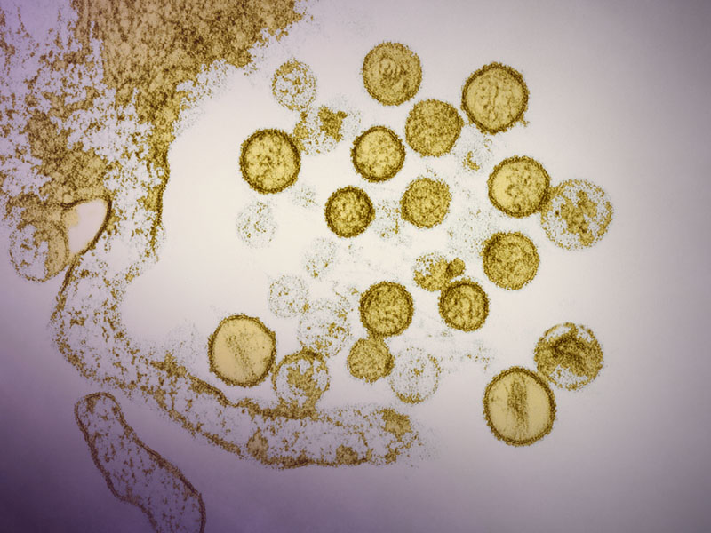
SUNLIGHT
Besides warming our earth, and making things grow, sunlight helps to keep our bodies healthy and strong. There are many ways that sunlight can help us.
Did you know that sunlight is a powerful germ-killer?
Sunlight destroys dangerous germs that can make us sick.
For this reason we should open up our homes each day and let the sunshine in.
Sunlight kills germs

Slide 6
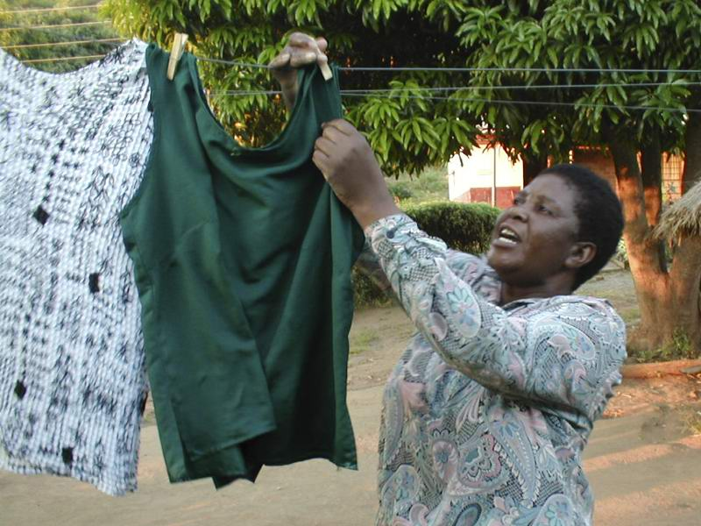
SUNLIGHT
Hanging our wet clothes to dry in the sunshine helps to purify them, and makes clothes cleaner than just washing them with soap. Every few weeks we should take our blankets, pillows, and other items that can’t be washed, out into the sunshine for a couple of hours to purify them.
Sunlight works very well to help prevent and remedy depression (or sadness).

Slide 7
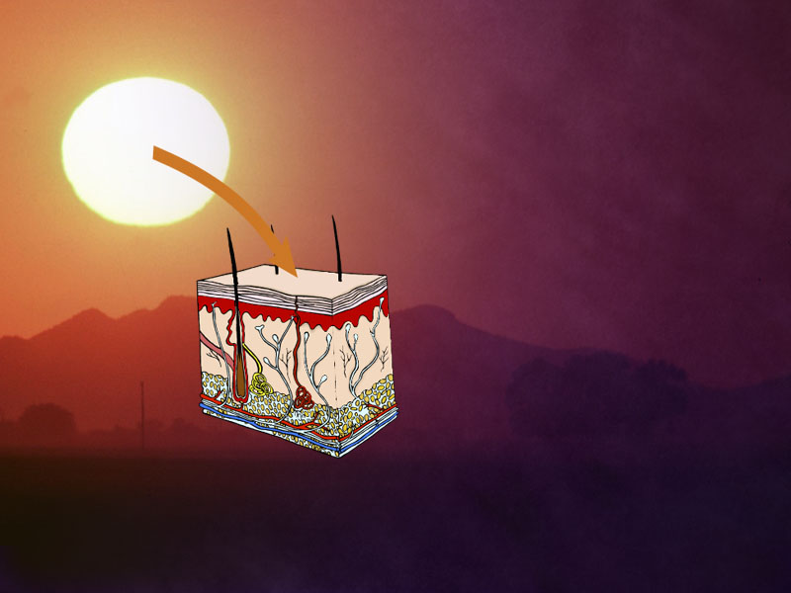
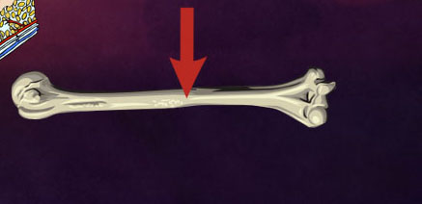
SUNLIGHT
When sunlight touches the skin,
…the body is able to make Vitamin D.
This helps the body to build strong, healthy bones.
Vitamin D

Slide 8
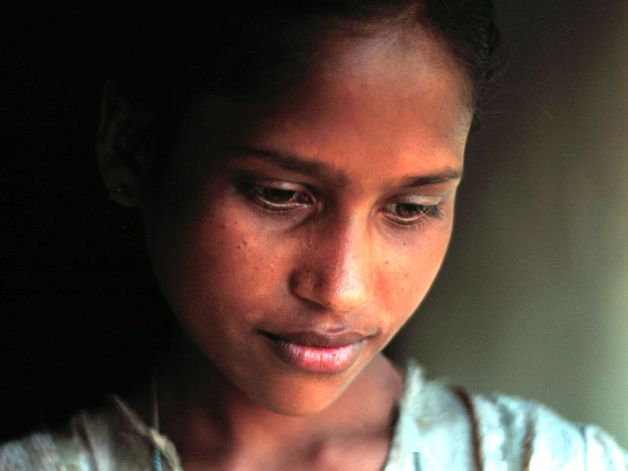
SUNLIGHT
Depression
Sunlight works very well to help prevent and remedy depression (or sadness). Being outdoors in the sunshine each day can take away the gloom and make nearly everyone feel better.
Notes:
Being outdoors in the sunshine each day can take away the
gloom and make nearly everyone feel better.

Slide 9
SUNLIGHT
Sunlight also strengthens our immune system, the army within our body, protecting us from sickness and disease.
A proper amount of sunshine gives the skin a healthy glow and makes it soft and pliable.
When sunlight touches the skin,
…the body is able to make Vitamin D.
This helps the body to build strong, healthy bones.

Slide 10
Vitamin D

Slide 11
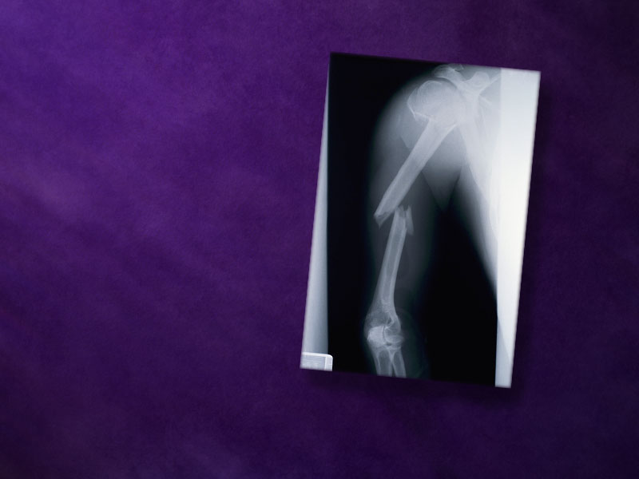
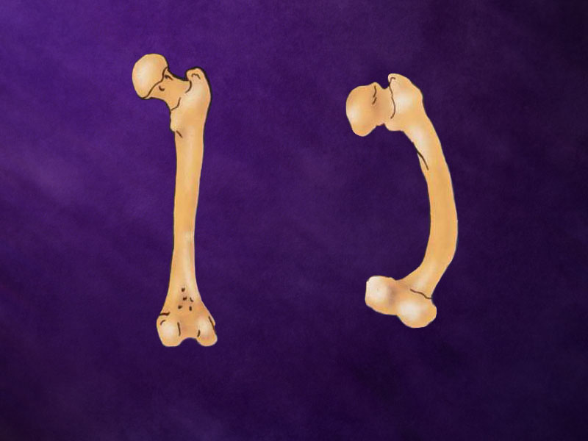
Vitamin D from sunlight also helps prevent bone diseases like osteoporosis and rickets.
Rickets is a disease that can make the bones soft and crooked, especially in children.
Helps prevent osteoporosis and rickets
Notes:
Vitamin D from sunlight also helps prevent bone diseases like
osteoporosis and rickets.
Rickets is a disease that can make the bones soft and crooked,
especially in children.

Slide 12
Just ten minutes of sunshine on the face and hands each day is enough for the body to make all the Vitamin D it needs.
10 minutes daily

Slide 13
A good hat and clothes that cover their arms and legs. All of these things can help prevent over exposure to too much sun.
Notes:
good hat and clothes that cover their arms and legs. All of these
things can help.
God intended sunshine

Slide 14
HEALTH SONG (refrain)
Health for you!
Health for me!
Health for all mankind!
Healing for the halt and lame,
And vision for the blind;
Health for you!
Health for me!
Health for all mankind!
This our goal:
Our body whole
In spirit, flesh, and mind.

Slide 15
HEALTH SONG
Sunshine and fresh air,
Clean and wholesome food,
Proper exercise,
Thoughts upright and good,
Keeps the cheeks aglow,
Bodies fit and strong,
Keep the brain alert and clean,
And give the heart a song!

Slide 16
HEALTH SONG (refrain)
Health for you!
Health for me!
Health for all mankind!
Healing for the halt and lame,
And vision for the blind;
Health for you!
Health for me!
Health for all mankind!
This our goal:
Our body whole
In spirit, flesh, and mind.

