Slide 1
GOD’S LAWS OF HEALTH
NUTRITION
EXERCISE
WATER
SUNLIGHT
TEMPERANCE
AIR
REST
TRUST IN GOD
NEWSTART

Slide 2
TEMPERANCE

Slide 3
TEMPERANCE
Ph'p:4:5: Let your moderation be known unto all men. The Lord is at hand.
Ga:5:22: But the fruit of the Spirit is …temperance: against such there is no law.
Ec:10:17: Blessed art thou, O land, when thy king is the son of nobles, and thy princes eat in due season, for strength, and not for drunkenness
NEWSTART

Slide 4
TEMPERANCE
True temperance teaches us to dispense entirely with everything hurtful, and to use judiciously that which is healthful. There are few who realize as they should how much their habits of diet have to do with their health, their character, their usefulness in this world, and their eternal destiny. MH
NEWSTART

Slide 5
TEMPERANCE
In today’s world, so many people find their lives so full of problems, and disappointments that they will do almost anything to feel good!

Slide 6
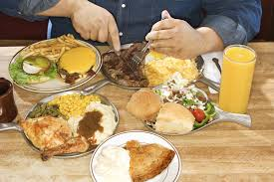
TEMPERANCE
GLUTTONY
Proverb:23:21: For the drunkard and the glutton shall come to poverty: and drowsiness shall clothe a man with rags.

Slide 7
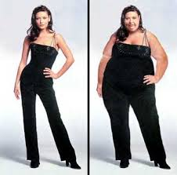
TEMPERANCE
OBESITY
The symptoms of obesity are weight gain and a body mass index (BMI) above 30. BMI is an estimate of your body fat content and is calculated using your height and weight measurements. Without proper treatment, obesity can lead to other serious health problems, such as: osteoarthritis.

Slide 8
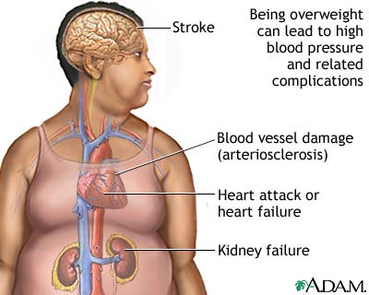
TEMPERANCE
OBESITY
A BMI of 18.5-24.9 is considered normal weight. For patients with a BMI over 40, life expectancy is reduced significantly. Obesity also increases the risk of developing a number of chronic diseases, such diabetes, high blood pressure, cancer, gout, heart attack, stroke, high cholesterol, gall stones, osteoarthritis

Slide 9
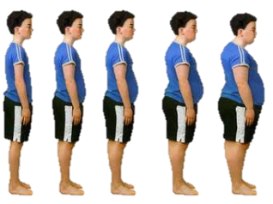
OBESITY
People who are obese are at increased risk for many diseases and health conditions, including the following: ^{10, 17, 18}
All-causes of death (mortality)
High blood pressure (Hypertension)
High LDL cholesterol, low HDL cholesterol, or high levels of triglycerides (Dyslipidemia)
Type 2 diabetes
Coronary heart disease
Stroke
Gallbladder disease
Osteoarthritis (a breakdown of cartilage and bone within a joint)
Sleep apnea and breathing problems
Chronic inflammation and increased oxidative stress^{19,20}
Some cancers (endometrial, breast, colon, kidney, gallbladder, and liver)
Low quality of life
Mental illness such as clinical depression, anxiety, and other mental disorders^{21,22}
Body pain and difficulty with physical functioning²³

Slide 10
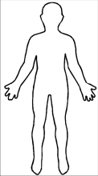
BODY MASS INDEX (BMI)
Measurement Units | Formula and Calculation
Kilograms and meters (or centimeters) | Formula: weight (kg) / [height (m)]² With the metric system, the formula for BMI is weight in kilograms divided by height in meters squared. Because height is commonly measured in centimeters, divide height in centimeters by 100 to obtain height in meters. Example: Weight = 68 kg, Height = 165 cm (1.65 m) Calculation: 68 ÷ (1.65)² = 24.98
Pounds and inches | Formula: weight (lb) / [height (in)]² x 703 Calculate BMI by dividing weight in pounds (lbs) by height in inches (in) squared and multiplying by a conversion factor of 703. Example: Weight = 150 lbs, Height = 5'5" (65") Calculation: [150 ÷ (65)²] x 703 = 24.96

Slide 11
BODY MASS INDEX (BMI)
How is BMI interpreted for adults?
For adults 20 years old and older, BMI is interpreted using standard weight status categories. These categories are the same for men and women of all body types and ages. The standard weight status categories associated with BMI ranges for adults are shown in the following table.
For example, here are the weight ranges, the corresponding BMI ranges, and the weight status categories for a person who is 5' 9".
Height | Weight Range | BMI | Weight Status
5' 9" | 124 lbs or less | Below 18.5 | Underweight
 | 125 lbs to 168 lbs | 18.5 to 24.9 | Normal or Healthy Weight
 | 169 lbs to 202 lbs | 25.0 to 29.9 | Overweight
 | 203 lbs or more | 30 or higher | Obese

Slide 12
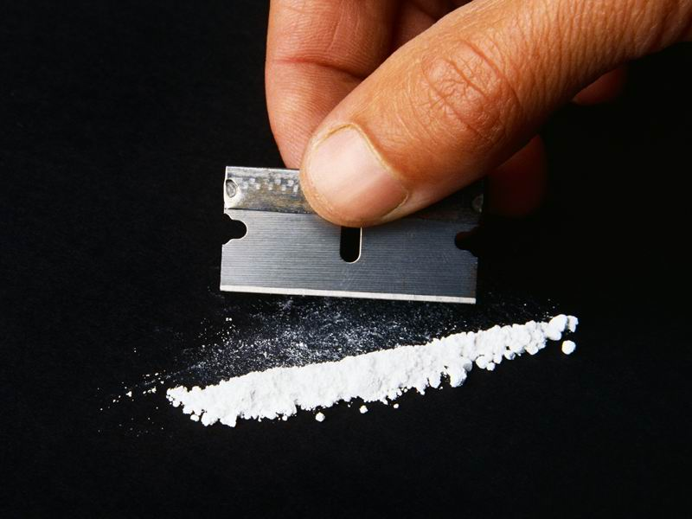
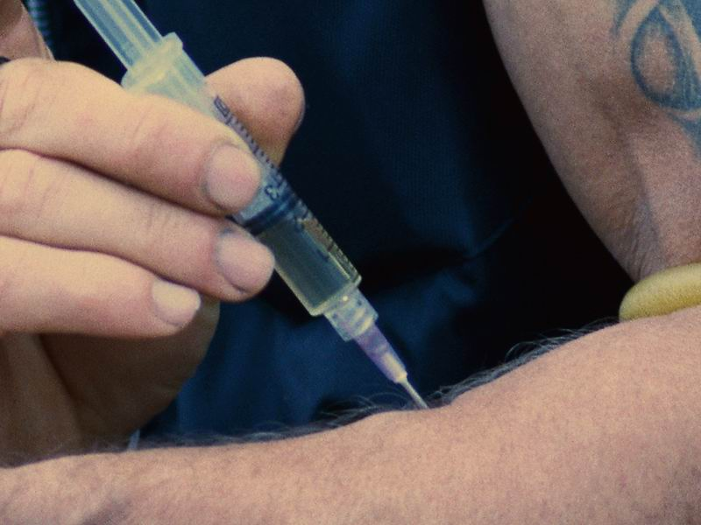
TEMPERANCE
DRUGS
Sniffing cocaine, glue, or some other substance will make them feel like they are in the clouds on their way to heaven…for about twenty to thirty minutes.
A shot of heroin, or some other drug may last a little longer.

Slide 13
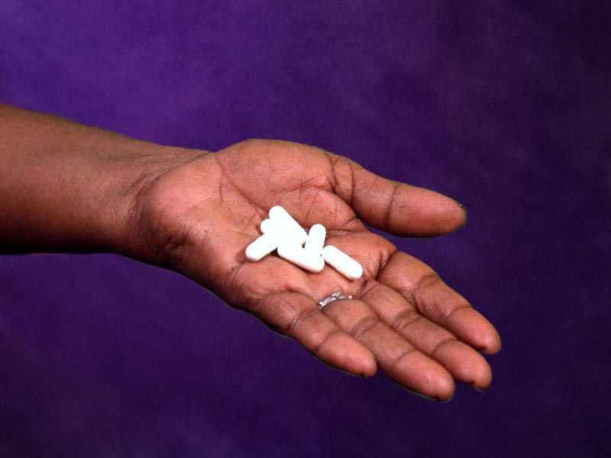
TEMPERANCE
PRESCRIPTION DRUGS
You need to be careful even with the drugs your doctor orders for you. Even these medicines, can be abused by
taking them longer than necessary,
taking the wrong amount, or
Taking them too often.

Slide 14
TEMPERANCE
Alcohol
But for most people, alcohol is the drug of choice.
At first alcohol seems so innocent, so comforting. But alcohol is actually one of the most dangerous drugs in the world.

Slide 15
TEMPERANCE-ABSTAIN
Le:10:9: Do not drink wine nor strong drink, thou, nor thy sons with thee, when ye go into the tabernacle of the congregation, lest ye die: it shall be a statute for ever throughout your generations:
Proverb:20:1: Wine is a mocker, strong drink is raging: and whosoever is deceived thereby is not wise.
NEWSTART

Slide 16
TEMPERANCE-ABSTAIN
Proverb:23:29: Who hath woe? who hath sorrow? who hath contentions? who hath babbling? who hath wounds without cause? who hath redness of eyes?
Proverb:23:30: They that tarry long at the wine; they that go to seek mixed wine.
NEWSTART

Slide 17
Wine Definition
Hebrews “Yayin”
Greek “Oinos”
“Juice of the Grape”
Fermented or Unfermented
Proverb:23:31: Look not thou upon the wine when it is red, when it giveth his colour in the cup, when it moveth itself aright.
Proverb:23:32: At the last it biteth like a serpent, and stingeth like an adder.
NEWSTART

Slide 18
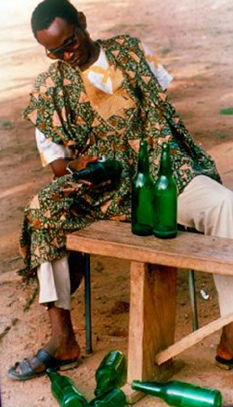
TEMPERANCE-ABSTAIN
Proverb:23:33: Thine eyes shall behold strange women, and thine heart shall utter perverse things.
Proverb:23:34: Yea, thou shalt be as he that lieth down in the midst of the sea, or as he that lieth upon the top of a mast.
Proverb:23:35: They have stricken me, shalt thou say, and I was not sick; they have beaten me, and I felt it not: when shall I awake? I will seek it yet again.
NEWSTART

Slide 19
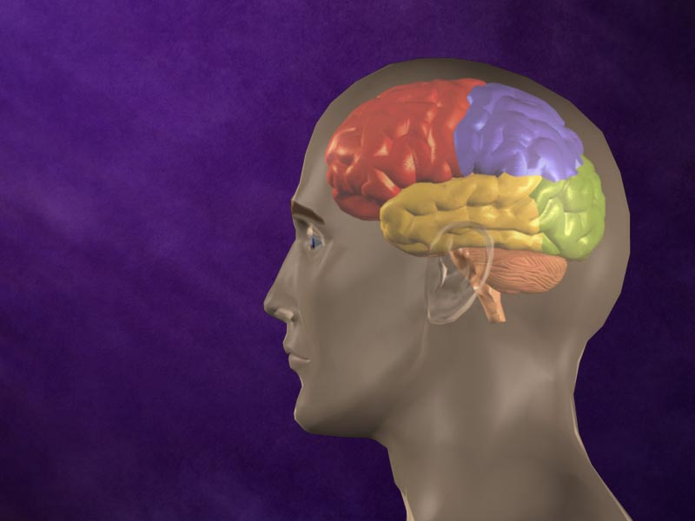
TEMPERANCE
Your brain
Alcohol affects Your brain – Even small amounts of alcohol cause permanent harm to brain cells; some die and others are damaged. Alcohol affects our judgement and weakens our ability to make correct moral decisions. As a result, the people we love the most are often hurt.

Slide 20
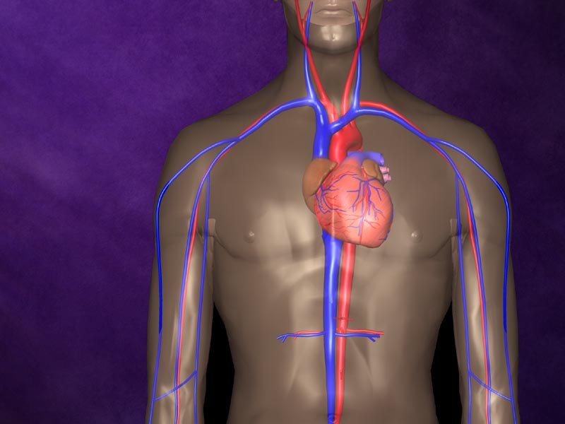
TEMPERANCE
Your heart
Alcohol affects Your heart – Alcohol increases the risk of high blood pressure, stroke, and damage to the heart muscle.

Slide 21
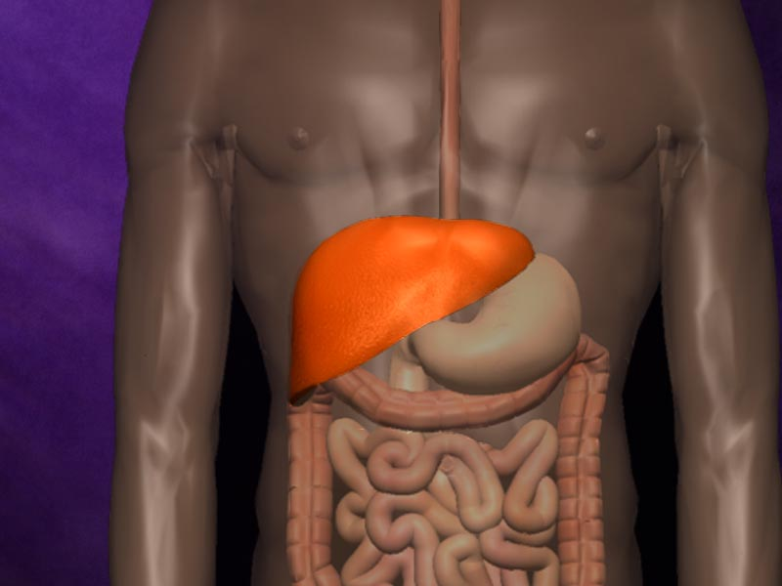
TEMPERANCE
Your liver
Alcohol affects Your liver – Because your liver must clean alcohol out of the blood, alcohol affects it more than any other part of your body. Healthy liver cells die from alcohol poisoning. Scars replace the dead cells, eventually ruining the liver (this is called liver cirrhosis)

Slide 22
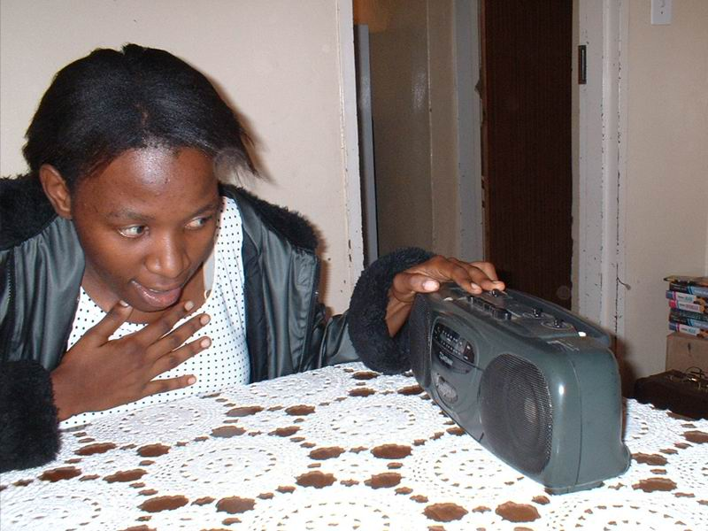
TEMPERANCE-ABSTAIN
Sexual Purity
1Co:6:18: Flee fornication. Every sin that a man doeth is without the body; but he that committeth fornication sinneth against his own body.
1Co:7:2: Nevertheless, to avoid fornication, let every man have his own wife, and let every woman have her own husband.
1Co:10:8: Neither let us commit fornication, as some of them committed, and fell in one day three and twenty thousand.

Slide 23
TEMPERANCE-ABSTAIN
Sexual Purity
The girl was afraid. She had heard on the radio that more and more people were dying from AIDS, a disease that is passed on from one person to another by sexual contact. Her heart started pumping hard as she thought that she might have this disease.

Slide 24
TEMPERANCE-ABSTAIN
She had a new boyfriend and had slept with him a few times. She didn’t know him very well but he looked like a nice person. He came from another town, to work for a construction company.

Slide 25
TEMPERANCE-ABSTAIN
He said he wasn’t married and that she was his only girlfriend. He even talked about marriage! But she noticed that soon after they slept together for the first time she became sick in the woman’s parts

Slide 26
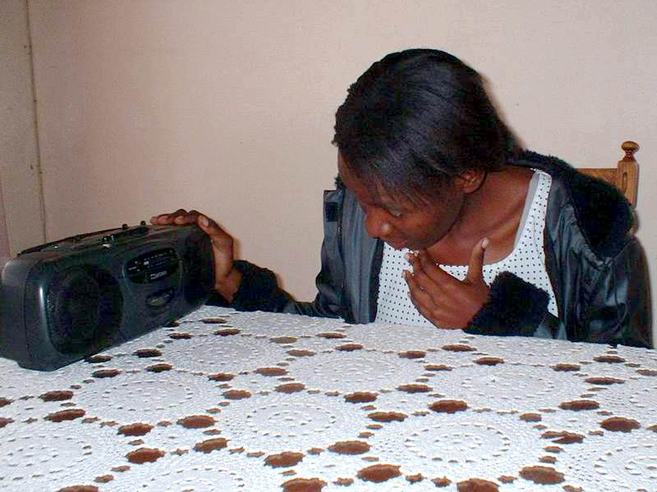
TEMPERANCE-ABSTAIN
She had not gone to the clinic because she thought it would get better on it’s own, but now, after listening to the radio, she was afraid! She wished she hadn’t slept with that man!

Slide 27
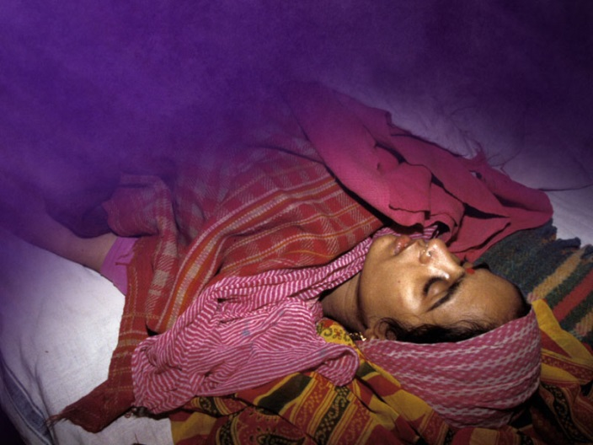
TEMPERANCE-ABSTAIN
Childlessness
Miscarriage
Brain Disease
Death

Slide 28
TEMPERANCE-ABSTAIN
This is why the only really safe solution is having sexual contact only with your marriage partner. Those who are not married are only safe by waiting until marriage and committing to one partner. If you have had other partners, you need to be tested for the HIV virus.
The only safe solution

Slide 29
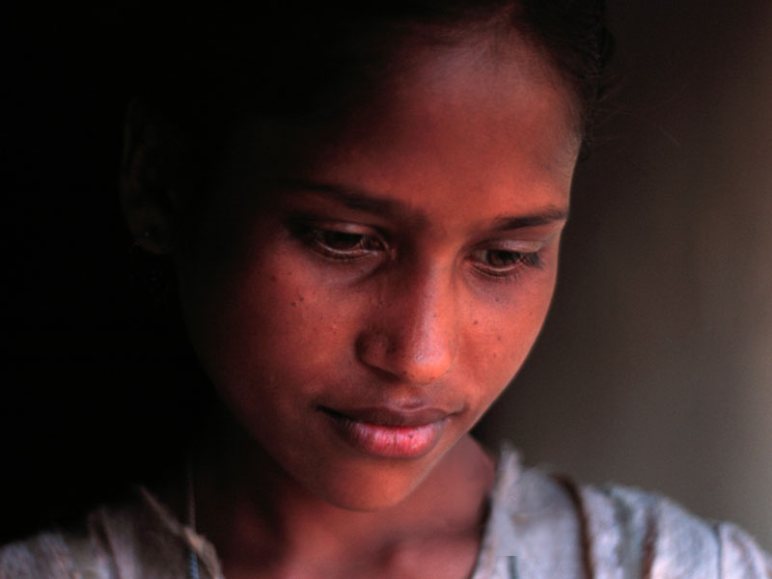
TEMPERANCE-ABSTAIN
Anyone who has had sexual contact with a person with gonorrhoea or chlamydia should also be treated. Even if they show no symptoms, they are probably infected. If not treated, they may become ill, or pass it on to others.

Slide 30
TEMPERANCE-ABSTAIN
Syphilis can cause:
Heart Disease
Paralysis
Insanity
Other serious problems
:

Slide 31
TEMPERANCE-ABSTAIN
As you see, there are many diseases that may be spread through sexual contact.

Slide 32
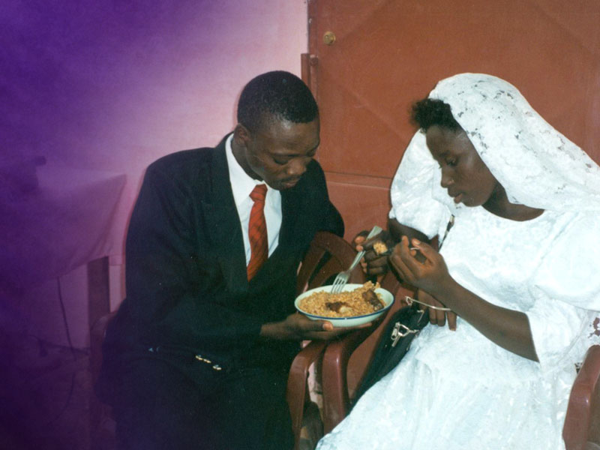
TEMPERANCE-ABSTAIN
Reserve sex for marriage The sexual relationship was meant to be enjoyed by a man and woman who have pledged to be with one another for the rest of their lives.
Reserve sex for marriage

Slide 33
HEALTH SONG (refrain)
Health for you!
Health for me!
Health for all mankind!
Healing for the halt and lame,
And vision for the blind;
Health for you!
Health for me!
Health for all mankind!
This our goal:
Our body whole
In spirit, flesh, and mind.

Slide 34
HEALTH SONG
If you want good health
God health laws obey;
All precepts heed,
Never from them stray;
Harmful habits shun,
Do not “push” yourself
When too tired – or you may find
‘Twill put you on “the shelf”!

Slide 35
HEALTH SONG (refrain)
Health for you!
Health for me!
Health for all mankind!
Healing for the halt and lame,
And vision for the blind;
Health for you!
Health for me!
Health for all mankind!
This our goal:
Our body whole
In spirit, flesh, and mind.

