Slide 1
GOD’S LAWS OF HEALTH
NUTRITION
EXERCISE
WATER
SUNLIGHT
TEMPERANCE
AIR
REST
TRUST IN GOD
NEWSTART

Slide 2
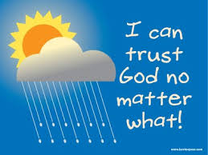
TRUST IN GOD

Slide 3
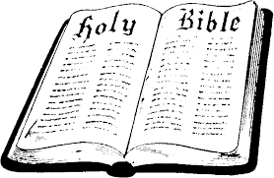
TRUST IN GOD
The scriptures declare that “God has chosen the foolish things of the world to put to shame the wise, and God has chosen the weak things of the world to put to shame the things which are mighty.” 1 Cor. 1:27 (NKJV)
3Jo:1:2: Beloved, I wish above all things that thou mayest prosper and be in health, even as thy soul prospereth.
Ga:6:7: Be not deceived; God is not mocked: for whatsoever a man soweth, that shall he also reap.

Slide 4
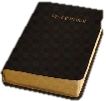
TRUST IN GOD
Ex:15:26: And said, If thou wilt diligently hearken to the voice of the LORD thy God, and wilt do that which is right in his sight, and wilt give ear to his commandments, and keep all his statutes, I will put none of these diseases upon thee, which I have brought upon the Egyptians: for I am the LORD that healeth thee.
De:7:15: And the LORD will take away from thee all sickness, and will put none of the evil diseases of Egypt, which thou knowest, upon thee; but will lay them upon all them that hate thee.
Psalms:103:3: Who forgiveth all thine iniquities; who healeth all thy diseases;
NEWSTART

Slide 5
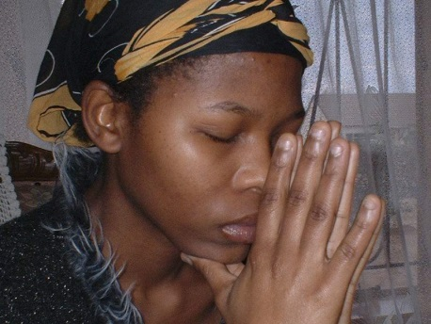
TRUST IN GOD
2Sa:22:31: As for God, his way is perfect; the word of the LORD is tried: he is a buckler to all them that trust in him.
Psalms:18:2: The LORD is my rock, and my fortress, and my deliverer; my God, my strength, in whom I will trust; my buckler, and the horn of my salvation, and my high tower.
NEWSTART

Slide 6
TRUST IN GOD
1Co:6:17: But he that is joined unto the Lord is one spirit.
1Co:6:18: Flee fornication. Every sin that a man doeth is without the body; but he that committeth fornication sinneth against his own body.
1Co:6:19: What? know ye not that your body is the temple of the Holy Ghost which is in you, which ye have of God, and ye are not your own?
1Co:6:20: For ye are bought with a price: therefore glorify God in your body, and in your spirit, which are God's.

Slide 7
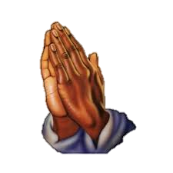
TRUST IN GOD
2Co:6:14: Be ye not unequally yoked together with unbelievers: for what fellowship hath righteousness with unrighteousness? and what communion hath light with darkness?
2Co:6:15: And what concord hath Christ with Belial? or what part hath he that believeth with an infidel?
2Co:6:16: And what agreement hath the temple of God with idols? for ye are the temple of the living God; as God hath said, I will dwell in them, and walk in them; and I will be their God, and they shall be my people.
2Co:6:17: Wherefore come out from among them, and be ye separate, saith the Lord, and touch not the unclean thing; and I will receive you,
2Co:6:18: And will be a Father unto you, and ye shall be my sons and daughters, saith the Lord Almighty.

Slide 8
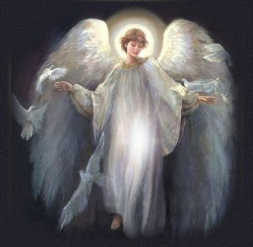
TRUST IN GOD
Re:22:2: In the midst of the street of it, and on either side of the river, was there the tree of life, which bare twelve manner of fruits, and yielded her fruit every month: and the leaves of the tree were for the healing of the nations.
Re:22:3: And there shall be no more curse: but the throne of God and of the Lamb shall be in it; and his servants shall serve him:
Re:22:4: And they shall see his face; and his name shall be in their foreheads.
Re:22:5: And there shall be no night there; and they need no candle, neither light of the sun; for the Lord God giveth them light: and they shall reign for ever and ever.
Re:22:12: And, behold, I come quickly; and my reward is with me, to give every man according as his work shall be.
Re:22:13: I am Alpha and Omega, the beginning and the end, the first and the last.
Re:22:14: Blessed are they that do his commandments, that they may have right to the tree of life, and may enter in through the gates into the city.

Slide 9
TRUST IN GOD
Regardless of any mistakes we may have made in the past, our Heavenly Father desires to help us have that special kind of heart so that our lives will bring forth good things and will allow us to enjoy a lifelong wonderful relationship with each other.
“A good man, out of the good treasure of his heart, brings forth good things...” Matthew 12:35

Slide 10
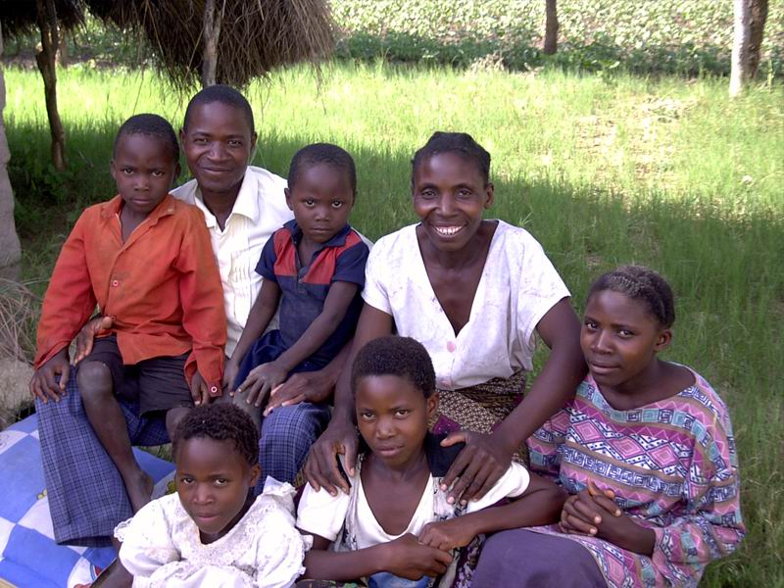
“He gives power to the weak, and to those who have no might he increases strength.” Isaiah 40:29
TRUST IN GOD

Slide 11
HEALTH SONG

Slide 12
HEALTH SONG (refrain)
Health for you!
Health for me!
Health for all mankind!
Healing for the halt and lame,
And vision for the blind;
Health for you!
Health for me!
Health for all mankind!
This our goal:
Our body whole
In spirit, flesh, and mind.

Slide 13
HEALTH SONG
If you want good health
God health laws obey;
All precepts heed,
Never from them stray;
Harmful habits shun,
Do not “push” yourself
When too tired – or you may find
‘Twill put you on “the shelf”!

Slide 14
HEALTH SONG (refrain)
Health for you!
Health for me!
Health for all mankind!
Healing for the halt and lame,
And vision for the blind;
Health for you!
Health for me!
Health for all mankind!
This our goal:
Our body whole
In spirit, flesh, and mind.

Slide 15
HEALTH SONG
Water is your friend!
Used within, without
Cleanses, soothes, and heals,
Puts the germs to rout;
Rest repairs the rents
Stress of living brings,
Loosens taut and “ragged” nerves
And gives the spirit wings!

Slide 16
HEALTH SONG (refrain)
Health for you!
Health for me!
Health for all mankind!
Healing for the halt and lame,
And vision for the blind;
Health for you!
Health for me!
Health for all mankind!
This our goal:
Our body whole
In spirit, flesh, and mind.

Slide 17
HEALTH SONG
Sunshine and fresh air,
Clean and wholesome food,
Proper exercise,
Thoughts upright and good,
Keeps the cheeks aglow,
Bodies fit and strong,
Keep the brain alert and clean,
And give the heart a song!

Slide 18
HEALTH SONG (refrain)
Health for you!
Health for me!
Health for all mankind!
Healing for the halt and lame,
And vision for the blind;
Health for you!
Health for me!
Health for all mankind!
This our goal:
Our body whole
In spirit, flesh, and mind.

