Slide 1
GOD’S LAWS OF HEALTH
NUTRITION
EXERCISE
WATER
SUNLIGHT
TEMPERANCE
AIR
REST
TRUST IN GOD
NEWSTART

Slide 2
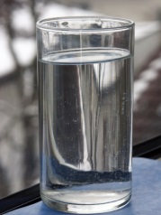
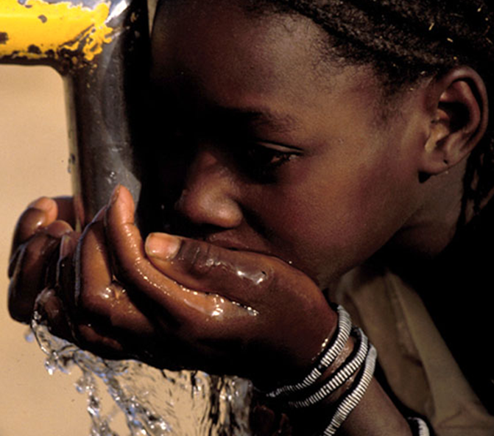
WATER
Water is the most healthful drink. We can only live a few days without it. Even though we usually get enough to live, most people don’t drink enough for their body to be able to work at its best. Today we want to talk about the many benefits of drinking water.
NEWSTART

Slide 3
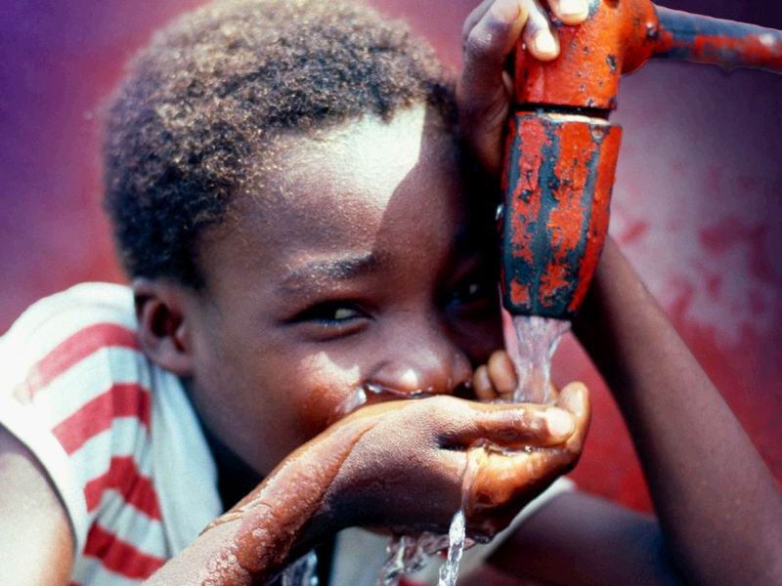
Drinking water is very important. We can live many more days without eating than we can without drinking. Doctors say that more than half of our weight is from water!
Notes:
Drinking water is very important. We can live many more days
without eating than we can without drinking. Doctors say that
more than half of our weight is from water!

Slide 4
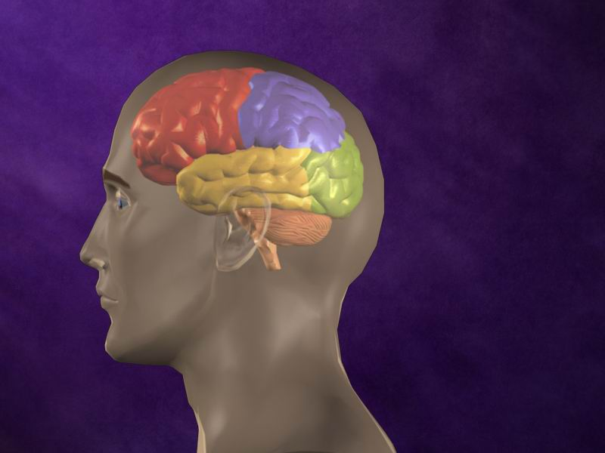
Water makes our brains work;
Notes:
Water makes our brains work;

Slide 5
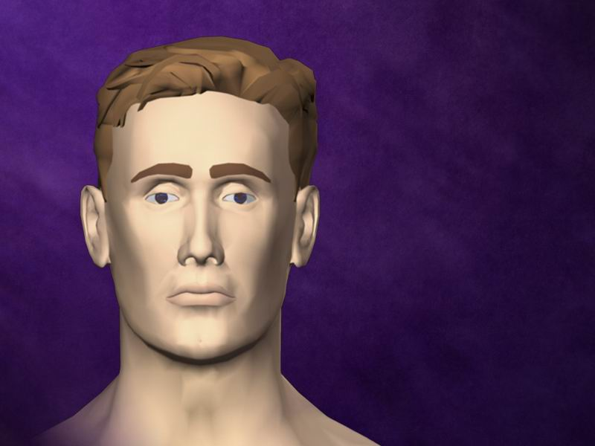
It makes the mouth and the eyes wet; and it allows the blood to move in our veins.
Notes:
it makes the mouth and the eyes wet;
!
and it allows the blood to move in our veins.

Slide 6
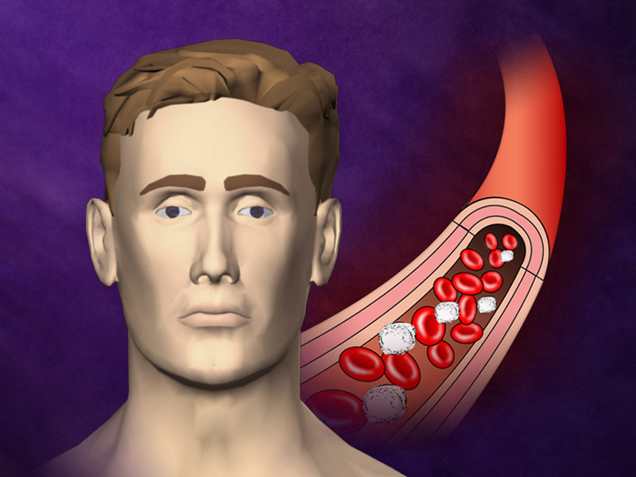
and it allows the blood to move in our veins.
Water also cleans
our blood from all the waste.

Slide 7
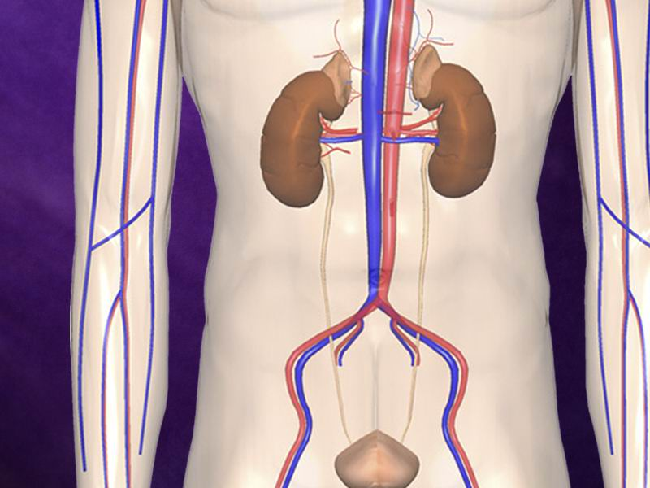
Water also cleans
our blood from all the waste.
It takes the dirty part of the blood to the kidneys and washes it
out.
Notes:
Water also cleans
our blood from all the waste.
©Life Art #3D209008
It takes the dirty part of the blood

Slide 8
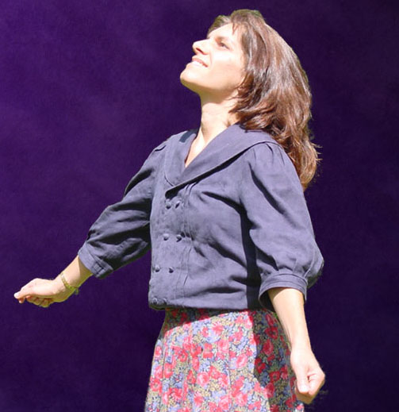
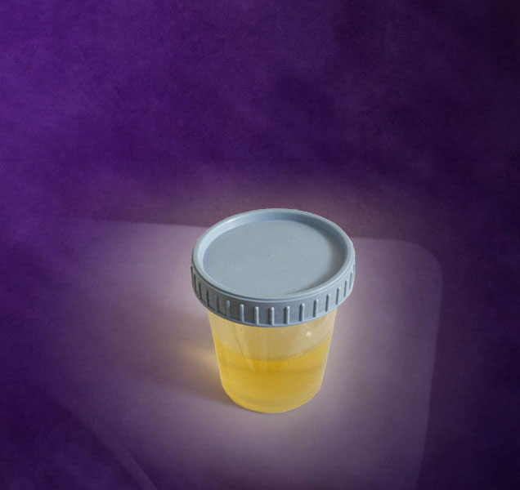
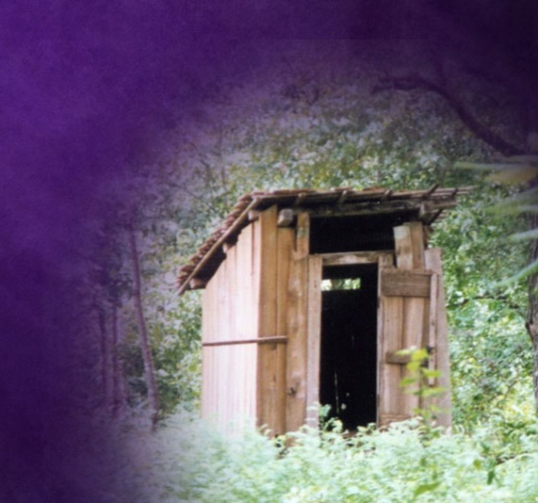
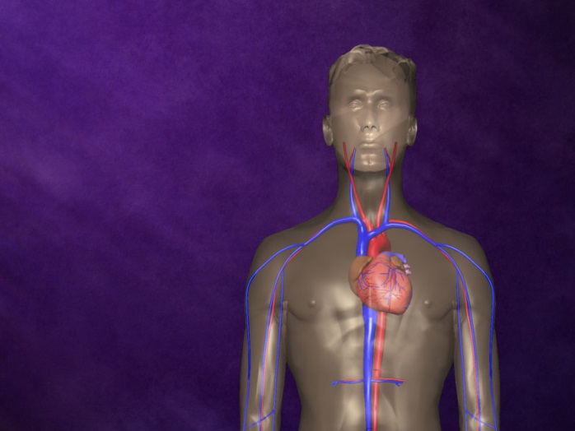
How do we lose water?
Urine
Stools
Sweat
Breathing
Notes:
Everyday our bodies lose water, even when we are sleeping.
We lose water in the…
! Urine
! Stools
! Sweat
! and Breathing
©Life Art #3D110005
Our blood needs to be

Slide 9
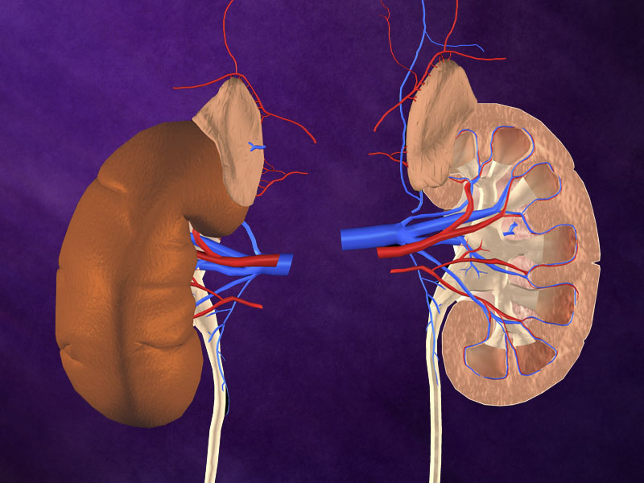
Our blood needs to be cleaned all the time. The kidneys help to
clean the blood; they work day and night doing this. The
kidneys throw out the dirty part of the blood in the urine; this is
how our blood is kept clean
Urine
Notes:
Our blood needs to be cleaned all the time. The kidneys help to
clean the blood; they work day and night doing this. The
kidneys throw out the dirty part of the blood in the urine; this is
how our blood is kept clean

Slide 10
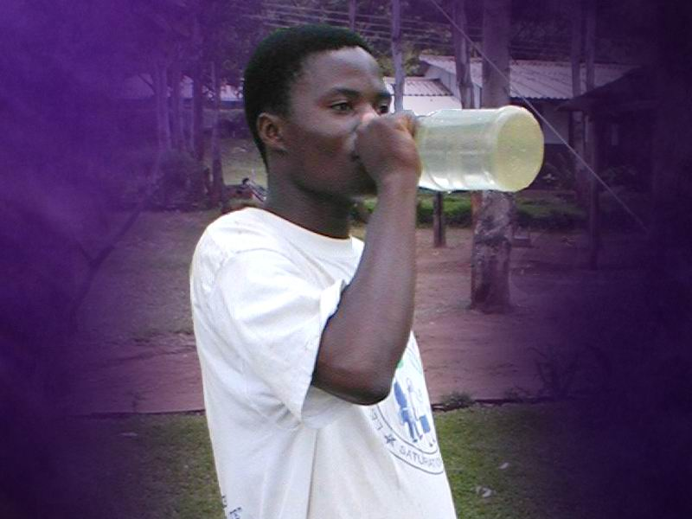
When we drink a lot of water, we help the kidneys to do their job. When we drink very little water, the kidneys have to work
hard to keep the blood clean.
Notes:
When we drink a lot of water, we help the kidneys to do their
job. When we drink very little water, the kidneys have to work
hard to keep the blood clean.

Slide 11
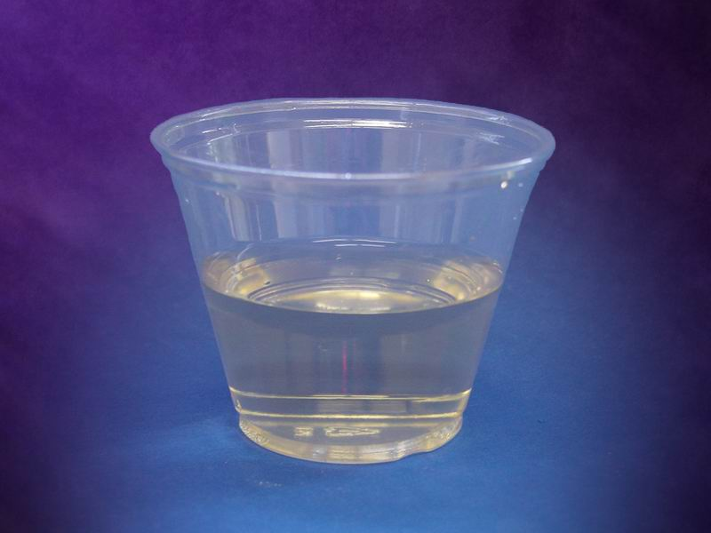
You may have seen that when you drink a lot of water, the urine is very clear, almost like water. This is good. It means that there is plenty of water to wash the waste out.
Notes:
You may have seen that when you drink a lot of water, the
urine is very clear, almost like water. This is good. It means
that there is plenty of water to wash the waste out.

Slide 12
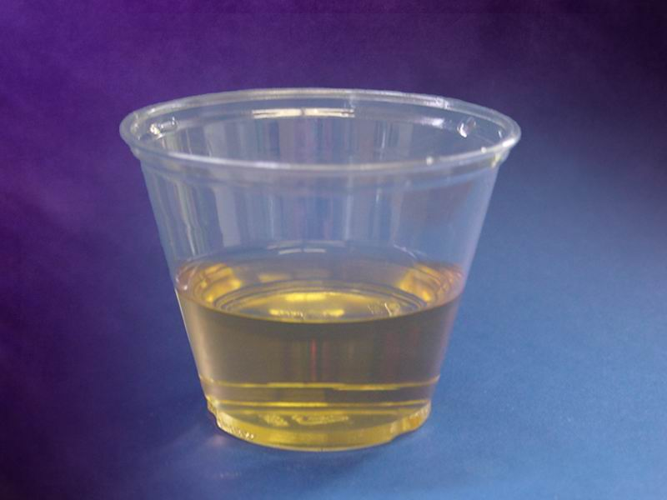
What happens when we don’t drink enough water? The urine becomes very yellow, and it may even smell bad. This is one way the body warns us that we should have been drinking more water.
Notes:
What happens when we don’t drink enough water? The urine
becomes very yellow, and it may even smell bad. This is one
way the body warns us that we should have been drinking more
water.

Slide 13
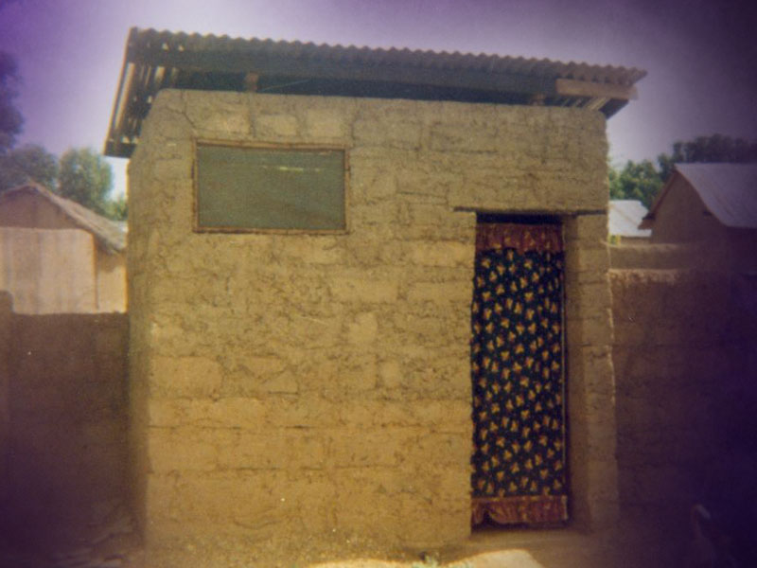
Another way we lose water from our body is with the stools we pass. When people have diarrhoea, they lose a lot more water and can even die. That is why it is so important to drink a lot of water when you have diarrhoea.
Stools
Notes:
Another way we lose water from our body is with the stools we
pass. When people have diarrhoea, they lose a lot more water
and can even die. That is why it is so important to drink a lot of
water when you have diarrhoea.

Slide 14
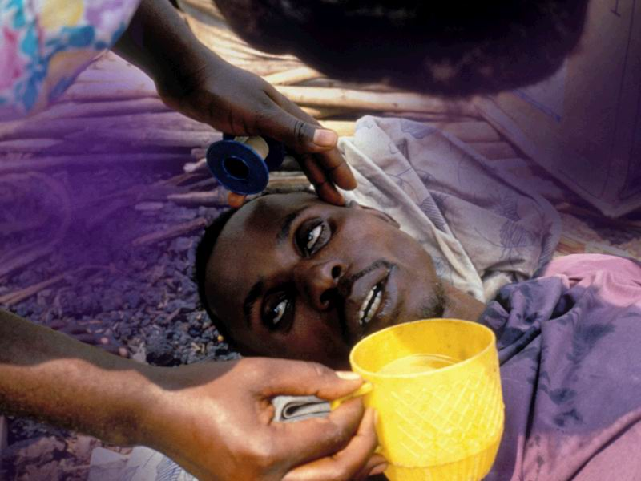
DIARRHOEA
Some people think that when they have diarrhoea they must
stop drinking water so that the diarrhoea will stop. This is very wrong! The diarrhoea will continue even if you stop drinking.
But if you don’t drink enough water to put back what is lost,
your body will not have enough fluid to make you well.
Notes:
Some people think that when they have diarrhoea they must
stop drinking water so that the diarrhoea will stop. This is very
wrong! The diarrhoea will continue even if you stop drinking.
But if you don’t drink enough water to put back what is lost,
your body will not have enough fluid to make you well.

Slide 15
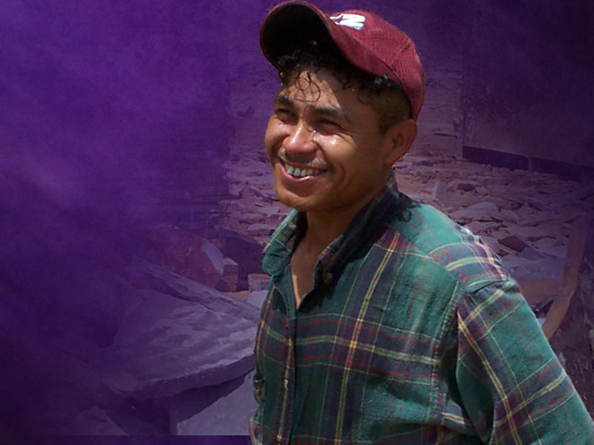
Sweat
Sweating is another way our bodies lose water. Especially when it is hot and people sweat a lot. Sweating helps the body
to stay cool. It is actually good for us; it helps to clean the blood.
Notes:
Sweating is another way our bodies lose water. Especially
when it is hot and people sweat a lot. Sweating helps the body
to stay cool. It is actually good for us; it helps to clean the
blood.

Slide 16
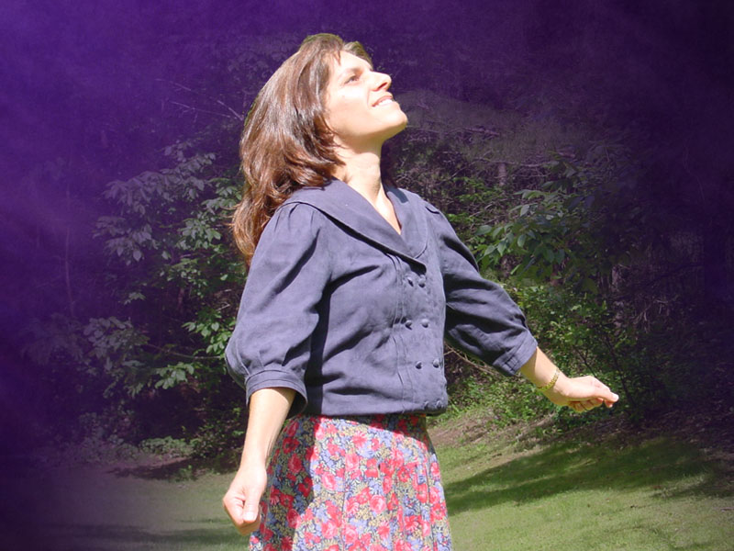
Breathing
Have you ever counted how many times you breathe in one minute? Adults usually breathe 15 times in one minute and
babies breathe much faster, even up to 40 times a minute.
Notes:
Have you ever counted how many times you breathe in one
minute? Adults usually breathe 15 times in one minute and
babies breathe much faster, even up to 40 times a minute.

Slide 17
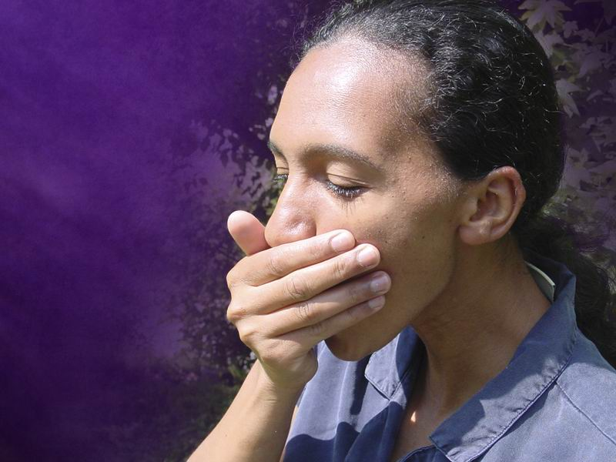
Just take your hand and cover your mouth with it. Then breathe out, blowing onto your hand. What happens? Your hand gets a little bit wet from the air that comes out of your lungs.
Notes:
Just take your hand and cover your mouth with it. Then breathe
out, blowing onto your hand. What happens? Your hand gets a
little bit wet from the air that comes out of your lungs.

Slide 18
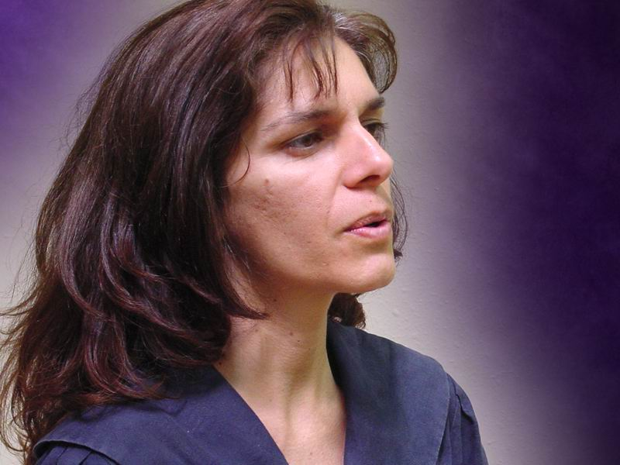
Every time a person breathes out, a little bit of water is lost from the lungs. In one day, we breathe in and out thousands of times. Each day almost 1 cup of water is lost from the body, just from breathing.
Notes:
Every time a person breathes out, a little bit of water is lost
from the lungs. In one day, we breathe in and out thousands of
times. Each day almost 1 cup of water is lost from the body,
just from breathing.
As you can see, there are many different ways in which we lose
water from the body.

Slide 19
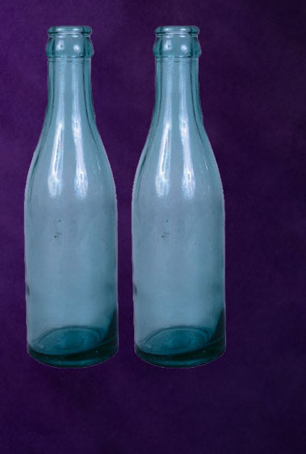
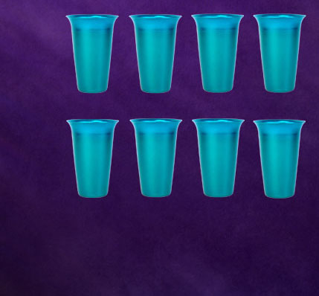
How much water do we need?
Notes:
How much water do we need?
!
An adult person should drink at least 2 litres (quarts) of water
every day.
!
This is the same as 8 glasses.

Slide 20
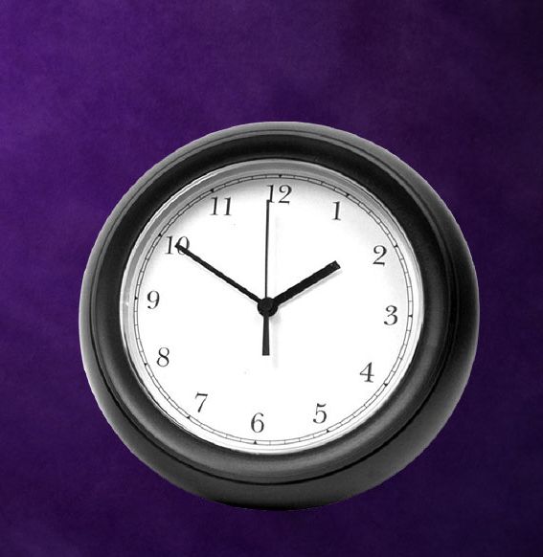
When should we drink water?
Notes:
When should we drink water?

Slide 21
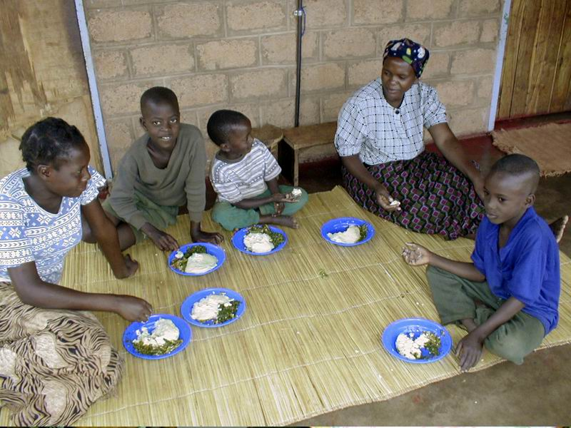
We should not drink with our meals. Why? Because water makes the food stay in the stomach for a very long time, and then the stomach gets tired and even sick.
Notes:
It is much better to drink water when there isn’t too much food
in the stomach. This means we should not drink with our
meals. Why? Because water makes the food stay in the
stomach for a very long time, and then the stomach gets tired
and even sick.

Slide 22
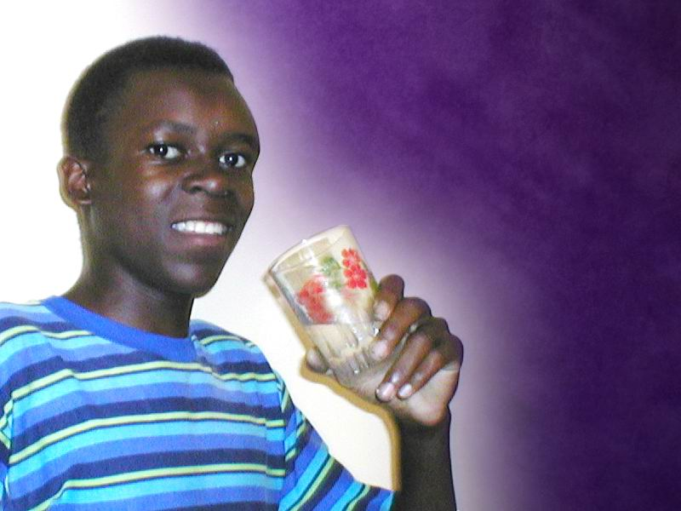
2 glasses when you wake up
2 hours after meals
Notes:
The best time to drink water is early in the morning and
between meals.
!
Begin your day by drinking 2 glasses of water when you wake
up.
!
After eating each meal—breakfast, lunch or supper—wait 2
hours and then drink two glasses.

Slide 23
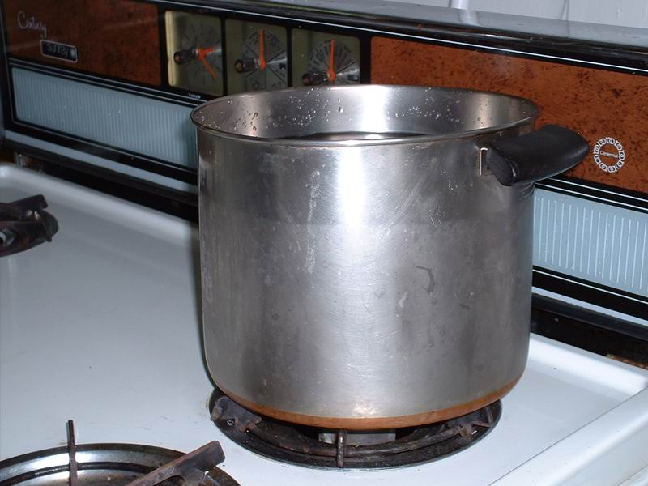
If your water is not safe, boil all the water you drink. You only need to boil water for 10 minutes to kill the germs that spread disease.
Notes:
If your water is not safe, boil all the water you drink. You only
need to boil water for 10 minutes to kill the germs that spread
disease.

Slide 24
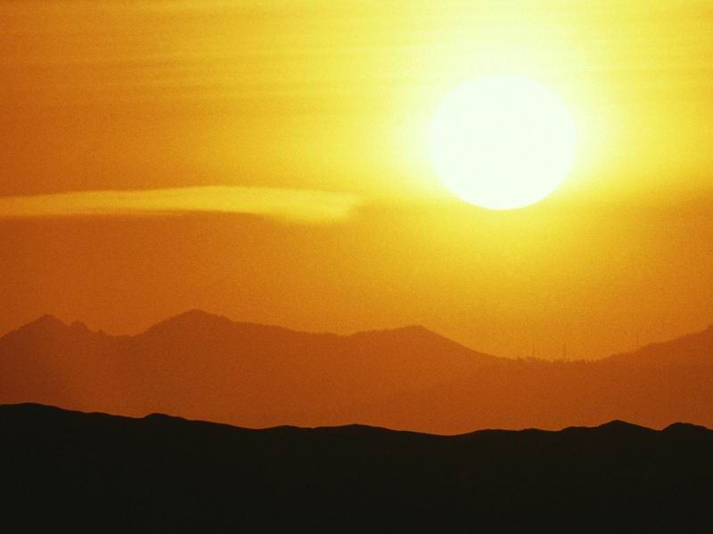
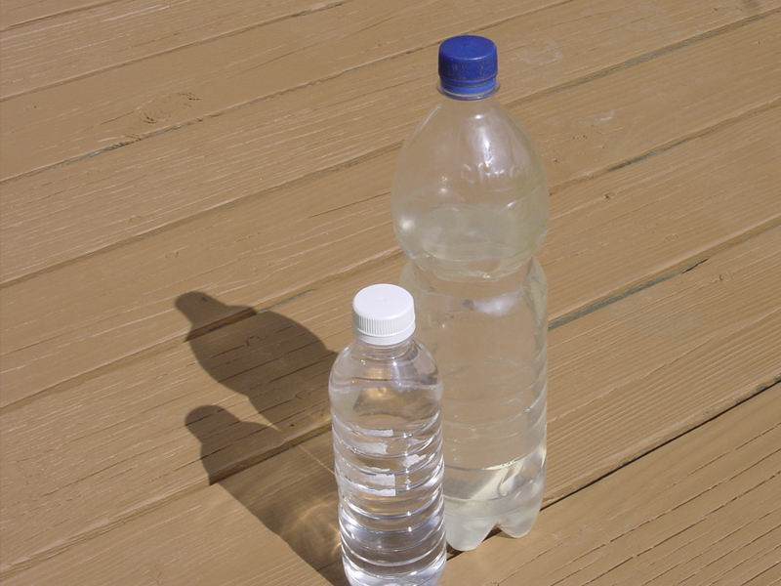
If you don’t have enough money for gas or wood to make a fire, then you can use the sun to clean your water.
To do this you will need glass or plastic bottles that you can see through. Fill them with water, close them and put them in
the sun for a whole day. Even though the sun doesn’t kill all the germs that can make you sick, most of them are killed, and the water becomes much safer to drink.1
Notes:
To do this you will need glass or plastic bottles that you can
see through. Fill them with water, close them and put them in
the sun for a whole day. Even though the sun doesn’t kill all
the germs that can make you sick, most of them are killed, and
the water becomes much safer to drink.1

Slide 25
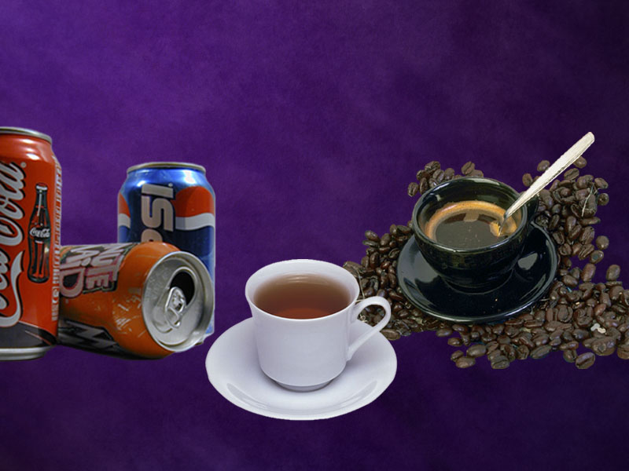
What about tea, coffee and soft drinks?
Notes:
Does it matter if we drink tea, coffee or soda drinks instead of
water?
Yes! These drinks cannot take the place of drinking water
Tea and coffee are not good drinks for our bodies. They can
damage our health and in time make us sick.

Slide 26
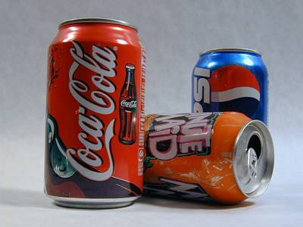
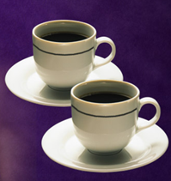
CAFFEINATED DRINKS
Caffeine relaxes the muscles at the upper end of the stomach. As a result, partially digested food may leak from the stomach back into the esophagus, causing heartburn.
Caffeinated drinks also stimulate the stomach to produce more acid. This can contribute to the development of painful ulcers.

Slide 27
CAFFEINATED DRINKS
Caffeine increases the risk of ovarian and pancreatic cancer.
Coffee is known to elevate blood pressure, and to increase the chances of a stroke or heart attack.
Five cups per day may increase coronary artery disease by 300%!
Caffeine may also:
➲ Increase the heart rate
➲ Cause irregular beats

Slide 28
CAFFEINATED DRINKS
➲ Raise cholesterol, and
➲ Accelerate blood clotting, leading to a heart attack.
Caffeine is an addictive drug and regular use of even small amounts usually leads to dependency.
Choosing to stop drinking coffee, tea, or soft drinks is a wise choice, but for many it is not easy.

Slide 29
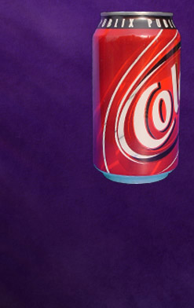
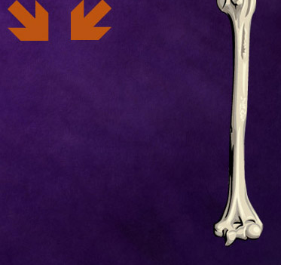
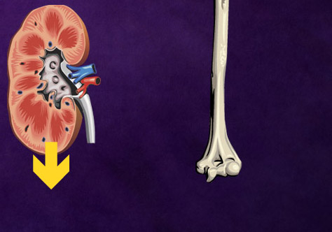
SOFT DRINKS W/O CAFFEINE
Phosphoric Acid
Even if a soft drink is caffeine free, most contain phosphoric acid, or phosphorus.
Phosphorous combines…
…with calcium, depleting the body of this essential mineral…
…by eliminating it through the kidneys.
Calcium
Phosphorus

Slide 30
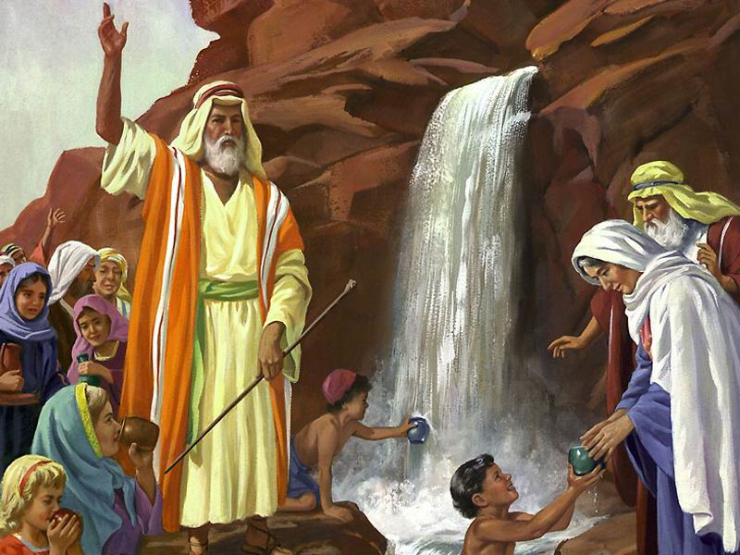
The Bible tells us of many times when God provided His people with pure water as they travelled through the wilderness.
Notes:
The Bible tells us of many times when God provided His
people with pure water as they travelled through the
wilderness.

Slide 31
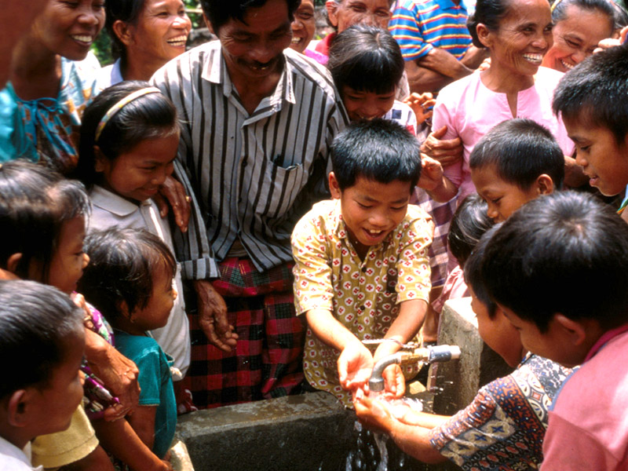
“He who has compassion on them will guide them and lead them beside springs of pure water.” Isaiah 49:10
Notes:
God still cares for us today, and wants to help us with all of our
needs.
!
The Bible says, “He who has compassion on them will guide
them and lead them beside springs of {pure} water.” (Isaiah
49:10)
Be sure you and your family have good clean water, and drink
plenty of it every day. This will help keep your bodies strong
and healthy, like God wants you to be.

Slide 32
HEALTH SONG (refrain)
Health for you!
Health for me!
Health for all mankind!
Healing for the halt and lame,
And vision for the blind;
Health for you!
Health for me!
Health for all mankind!
This our goal:
Our body whole
In spirit, flesh, and mind.

Slide 33
HEALTH SONG
Water is your friend!
Used within, without
Cleanses, soothes, and heals,
Puts the germs to rout;
Rest repairs the rents
Stress of living brings,
Loosens taut and “ragged” nerves
And gives the spirit wings!

Slide 34
HEALTH SONG (refrain)
Health for you!
Health for me!
Health for all mankind!
Healing for the halt and lame,
And vision for the blind;
Health for you!
Health for me!
Health for all mankind!
This our goal:
Our body whole
In spirit, flesh, and mind.

